Slide 1
How data analytics can drive greater results
Amy Bloedorn, CoreSource

Slide 2

How CoreSource delivers value with data
Data is Worthless – It’s How You Use it that Matters!
Member Behavior Data – Data based on demographics, medical history and health status used to create customized messages designed to help individuals save money and stay healthy and engaged
Analytics and Consultative Services – Concise and strategic recommendations based on plan performance trend data
Case Studies – Robust population health, cost and utilization data identifies cost savings opportunities for the broker and client

Slide 3
Member behavior data

Slide 4





The data behind digital messaging
Robust analytics allow us to engage members with tailored, targeted and timely information
Member goes to doctor or pharmacy
1
6
2
Member is smarter, more confident and informed
Provider submits claim to CoreSource for processing
5
3
4
CoreSource sends tailored message to member
Eligibility and Claims data is processed, stored and analyzed
CoreSource mines data for relevant information

Slide 5
What value does digital messaging provide?
Potential Cost Savings – members can save money by being informed about lower cost services driving lower plan cost and better utilization of new services.
Example: Opportunity to utilize Telemedicine vs. ER or Urgent Care
Example: Notified when a brand name drug is scheduled to become generic
Stay Healthy – members are empowered to better manage their health.
Example: May be notified when due for preventative services
Example: May be notified when gaps in care are detected
Employee Engagement – members are informed and engaged in their benefit options.
Example: Notified and reminded of new services such as transparency tools and telemedicine

Slide 6
The data behind digital messaging ER avoidance
CoreSource identifies members who visited the ER recently for diagnoses that are commonly treated via Telemedicine
CoreSource sends a text message to members reminding them that they have telemedicine as part of their benefits and that they would save $2,600 on average by utilizing telemedicine compared to an ER visit

Slide 7
The data behind digital messaging Generic Drugs
CoreSource identifies members who filled a script recently for a brand name drug that is scheduled to become generic
CoreSource sends a text message to members informing them that one of the drugs they are taking is becoming generic and they can potentially save money by switching to the generic version
Member is smart, informed and ready to have a conversation with their doctor

Slide 8
Analytics and consultative services
Notes:
CoreSource has invested in analytics over the last year and hired data analysts
Analysts support clients, brokers and internal staff by using data to answer complex questions and solve specific problems
Analysts may produce and present strategic reporting packages to clients on an annual, semi-annual or quarterly basis
Analysts may also perform benefit plan modeling services

Slide 9
Analytics and consultative services
It’s about insight and action.
What does the data mean for my client and what should we do about it?
Key Insights – High Level Summary Report when you want the top line
Raw Data to Meet your Needs – Ability to provide the raw data you need to integrate with your current client reporting and renewal packages
Comprehensive Analytics Package – Robust population health, cost and utilization data identifies cost savings opportunities for the broker and client

Slide 10
Key insights – Delivering the top line
Concise automated report that identifies Key Cost Drivers around:
Employee Cost Sharing %
Medical Cost and Utilization
Pharmacy Cost and Utilization
Condition Management
Facilitates consultative conversations with clients
Determines where there is a need for additional analysis and information gathering
Notes:
CoreSource has invested in analytics over the last year and hired data analysts
Analysts support clients, brokers and internal staff by using data to answer complex questions and solve specific problems
Analysts may produce and present strategic reporting packages to clients on an annual, semi-annual or quarterly basis
Analysts may also perform benefit plan modeling services

Slide 11
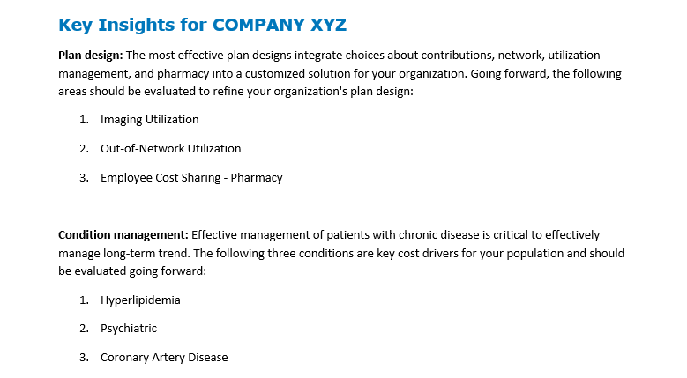
Key insights example

Slide 12
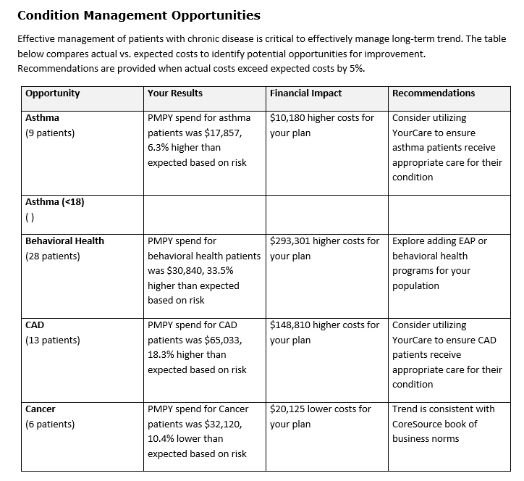
Key insights example

Slide 13
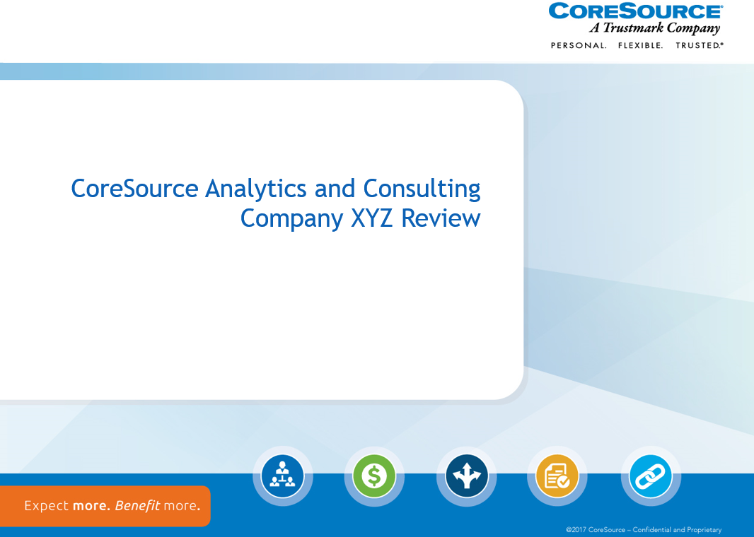
Comprehensive analytics package
Notes:
Discuss overall content, intended use, frequency of delivery

Slide 14
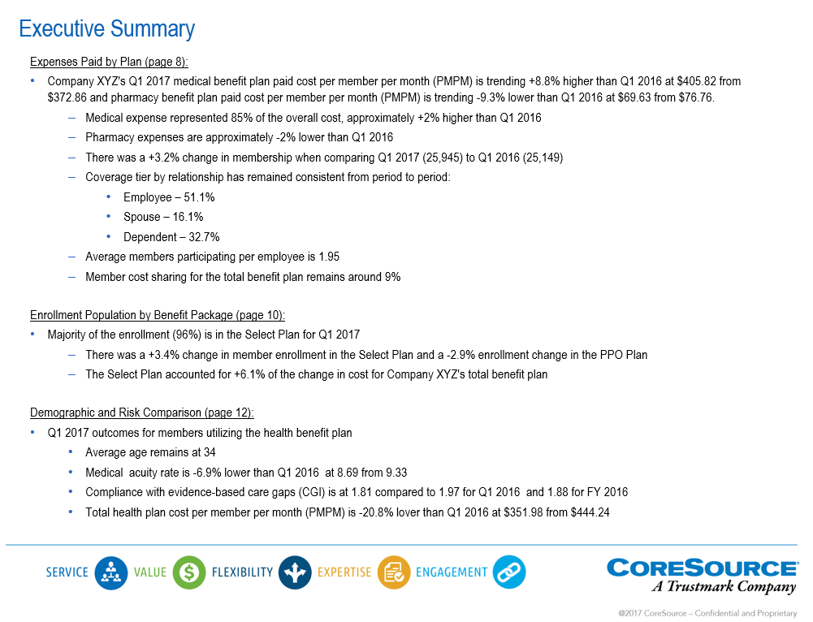
Comprehensive analytics package

Slide 15
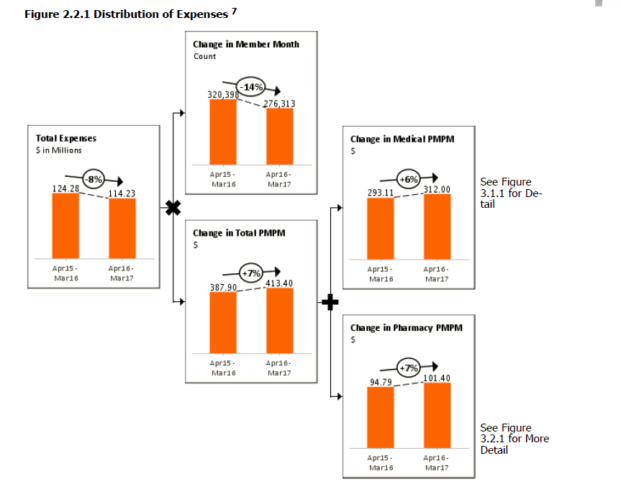
Comprehensive analytics package

Slide 16
Case studies

Slide 17
CoreSource case studies
Who: CoreSource Client, Large Hospital System
Business Problem: Client experienced increases in their average length of stay (ALOS) and wanted to understand the root cause
Approach: Analyzed client’s inpatient admission data by major diagnostic category and provider compared to 3 Managed Care Guideline (MCG) Models
Insights: Maternity ALOS for client was high when compared to all MCG models
Action: In Progress - Client is currently assessing clinical processes, operations and provider performance
Notes:
We were spending about $850M on claims and operating expense and generating $700M in premium annually. Vast majority (about $400M of expense was attributed to medical).

Slide 18
CoreSource case studies
Who: CoreSource Client, Small Fully insured with high pharmacy spend
Business Problem: Client started seeing a $27k script being paid without knowing what it was being taken for
Approach: Analyzed client’s data and learned a mail room employee was getting Remicaid at a hospital
Insights: Care Management team evaluated the best facilities and lowest costs for alternative pharmacy treatment and changed the place of service from Hospital to Special delivery and Home Health Care
Results: Member could now receive treatment in the comfort of their own home and cost went from $27k to $5,600 per script, representing a win/win for the employer and employee

Slide 19
We would like to hear from you!

